Slide 1
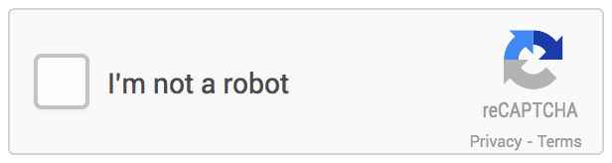

reCAPTCHA
Introduction…
Day 1
→By Narendranath Reddy

Slide 2


Agenda
Day1: Ther
Introduction
History
Types
Application
Process
Breaking captcha
Recaptcha
Unbreakable captcha
Benefits
Drawbacks
Conclusion
Reference
Day1: Theory
Day2: Practical
Day3: full explanation of Practical code and intro to Vanilla JS

Slide 3
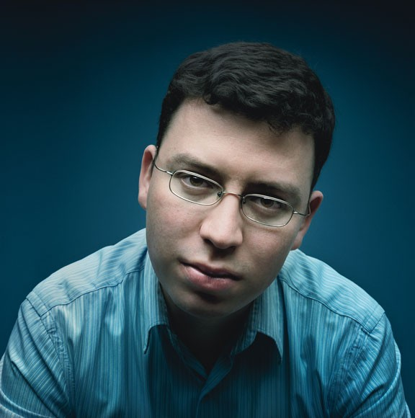
CAPTCHA
Inventor
Luis
von
Ahn
(1978
-
)
5
Photograph by Mike McGregor

Slide 4
CAPTCHA
What is CAPTCHA?
A program that can tell whether
human or a computer.
its user is a
It uses a type of challenge-response test to
determine that the
by a computer.
response
is
not
generated
6

Slide 5







What is CAPTCHA??
Continues…
CAPTCHA (Completely Automated Public
Turing
Test To Tell Computers and Humans Apart).
The P for Public means that the code and the
data used by a CAPTCHA should be publicly
available.
T for “Turing Test to Tell” is because
CAPTCHAs are like Turing Tests.

Slide 6
What is CAPTCHA??
Continues…
Captcha is a program that protect website
against
that
bots by generating and grading
test
-Human can pass
but
-Computer program can’t

Slide 7
What
is CAPTCHA??
Continues…
Captcha requires
that the user types letters
or digits from distorted image appears on
screen.
If correct solution is entered than system assumes that response is generated
-by user. else
-by bots & access denied.

Slide 8
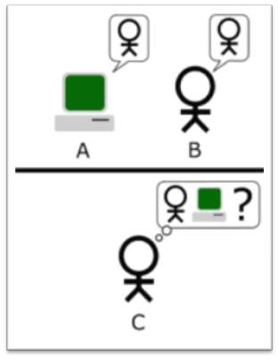
What is CAPTCHA??
Continues…
Standard Interpretation
▪ player C, the interrogator,
is tasked with trying to
determine which player
- A or B - is a computer and which is a human.

Slide 9
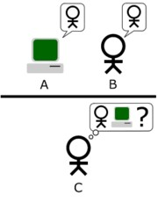
CAPTCHA
Turing Test
„Standard Interpretation"
player C, the interrogator,
is tasked with trying to determine which player
- A or B - is a computer and which is a human.
7

Slide 10
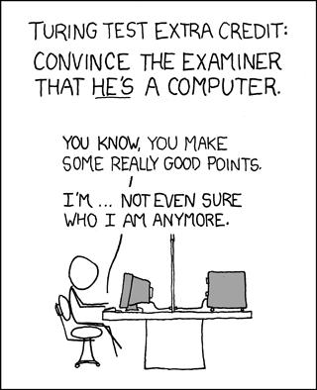
CAPTCHA
Reverse Turing Test
A CAPTCHA is
sometimes described
as a reverse Turing
test, because it is
administered by a machine and
targeted to a human.
8

Slide 11
CAPTCHA
So, CAPTCHA
is…
A program that
tests that:
can generate
and
grade
●
●
Most humans can pass;
Current computer programs
cannot pass.
9

Slide 12

History behind CAPTCHA
Captcha word comes from capture.
it is also known as reverse turing test.
About 200 million CAPTCHAs are solved
around the world every day.
by humans
First developed by Alta Vista in 1997.
The term coined in 2000 by Luis von Ahn, Manuel
Blum and Nicholas j. Hopper of Carnegie Mellon
university and john Langford of IBM.

Slide 13




Types of CAPTCHA
Text Based CAPTCHA
Gimpy,ez-gimpy
Gimpy-r, Google CAPTCHA
Simard’s HIP
Graphics Based CAPTCHA
Bongo
Pix
Audio Based CAPTCHA
▪
▪
▪
▪
▪

Slide 14
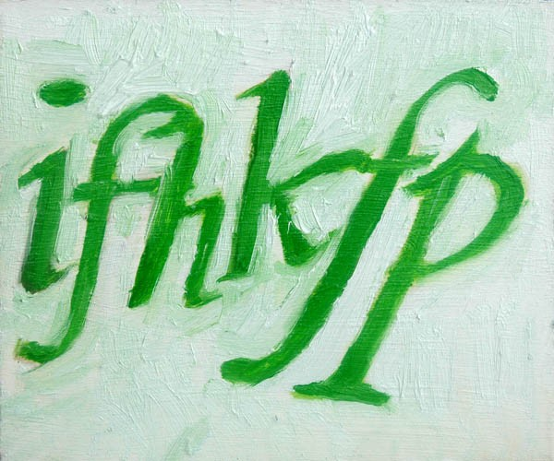
CAPTCHA
Making a CAPTCHA
Pick random
string of characters
(or words)
Renders it into a
distorted
image
ifhkfp
10

Slide 15
CAPTCHA
Making a
CAPTCHA
…
and
the
program
generates
a
test:
Type the characters that appear in the image
11

Slide 16
CAPTCHA
Outperform the computers
In many simple tasks, a typical 5-year-old
can outperform the most powerful computers
easier for computers:
●
•
•
like medical diagnosis,
playing chess,
●
hard for computers:
•
operations requiring vision,
motor control.
hearing, language or
12

Slide 17

CAPTCHA
Type: Early CAPTCHAs
●
●
Generated by the EZ-Gimpy
program;
Used
previously
on
Yahoo!
13

Slide 18

CAPTCHA
Type: Improved CAPTCHA
●
●
●
●
high contrast for human readability;
medium, per-character perturbation;
random fonts per character;
low
background
noise;
14

Slide 19
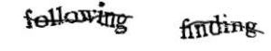
CAPTCHA
Type: A modern CAPTCHA
●
rather than attempting to create a distorted
background and high levels of warping on the text;
●
focus on making segmentation
difficult
by
adding
an
angled
line;
15

Slide 20
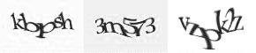
CAPTCHA
Type: A modern CAPTCHA
●
another way to make segmentation difficult
is to crowd symbols together;
●
this can be read by humans
but
cannot
be
segmented
by
bots;
16

Slide 21

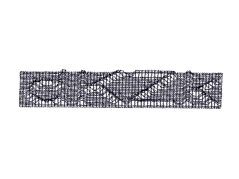
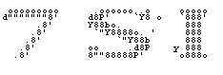
CAPTCHA
Other Types of CAPTCHA
●
Animated CAPTCHAs
●
3D CAPTCHA
●
ASCII art
●
Reverse CAPTCHA
"Leave this
field blank"
17

Slide 22
CAPTCHA
Other: Cognitive Puzzles
●
●
Distinguish pictures of dogs from cats
Choose a word that relates
images
Trivia questions
Math and word problems
3D Object CAPTCHA Solve failed OCR inputs
to
all
the
●
●
●
●
18

Slide 23
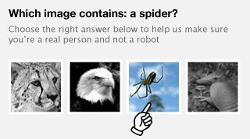
CAPTCHA
Other: Distinguish pictures
●
Microsoft Asirra (Animal
for Restricting Access);
Species
Image
Recognition
●
KittenAuth
Project .
19

Slide 24
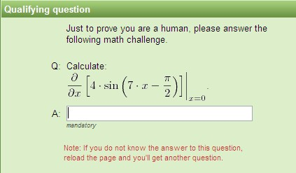
CAPTCHA
Other:
Mathematical
CAPTCHA
20

Slide 25
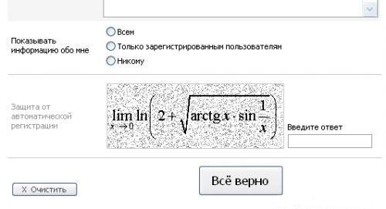
CAPTCHA
Other:
Mathematical
CAPTCHA
21

Slide 26
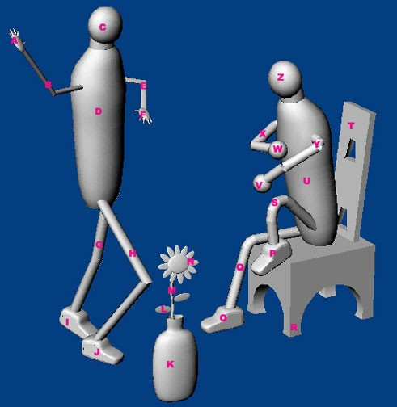

CAPTCHA
Other: 3D Object
CAPTCHA
You must enter them in
the exact sequence
listed:
•
The Head of the Walking
Man,
•
•
The
The
Vase,
Back
of
the
Chair.
22

Slide 27
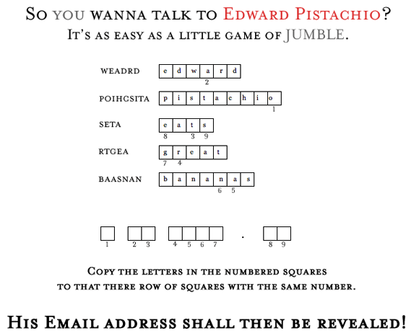
CAPTCHA
Other:
Jumble
Game
23

Slide 28
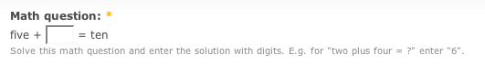
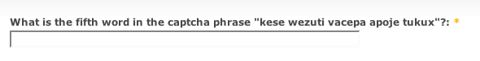
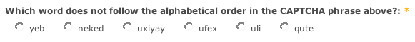

CAPTCHA
Other:
Drupal
Examples
24

Slide 29
CAPTCHA
Other: Tests
●
„Common Sense" questions:
•
•
„What is 3 + 5?“
„What color is the sky?"
●
●
Type the word 'orange';
Require a valid email to approve;
These
attempts violate principles:
cannot be automatically generated;
can be easily cracked given the state
•
•
they
they
of AI.
25

Slide 30


Text
Based
CAPTCHA
Gimpy
▪ Initially used by yahoo ,in this CAPTCHA two steps followed as:
a) Pick a word or words from a small dictionary b) Distort them and add noise and background
are

Slide 31


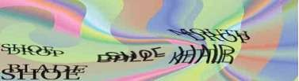
Text
Based
CAPTCHA
Gimpy-R
▪
This was used by
google and
was basically a simple
advance over gimpy. Here instead of a complete
word individual letters are noised instead of
complete words. steps followed are as:
a) Pick random letters
b) Distort them, add noise and background
Type three words appearing in the image.

Slide 32

Text
Based
CAPTCHA
Simcard’s
▪ Here further advances made
and arcs being made
into it ie. Curved geometrical shapes. Hence steps
followed are as:
a)Pick random letters and numbers b)Distort them and add arcs

Slide 33


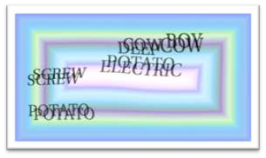
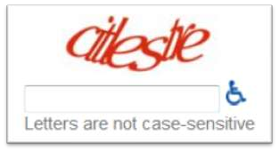
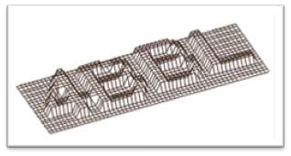
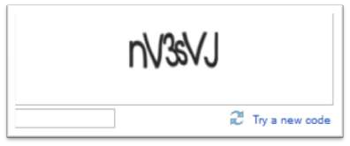
Some Screenshots of
Text Based CAPTCHA
Pictures of CAPTCHA
implemented by some popular
websites.

Slide 34

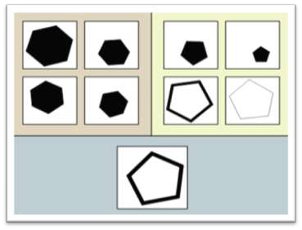
Graphics Based
CAPTCHA
Bongo
Following steps are followed in
BONGO CAPTCHAS as:
a)Display two series of blocks
b)User must find the characteristic
that sets the two series apart
c)User is asked to determine which series each of four single blocks belongs to.
▪
To which side does the block
on the bottom belong?

Slide 35
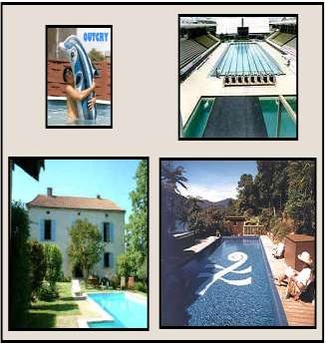
Graphics Based
CAPTCHA
Continues…
Pix
This is the second kind of graphics
CAPTCHA using distorted images.Steps
followed in its usage are as:
a) Create a large database of labeled
images
b) Pick a concrete object
c) Pick four images of the object from
the images database
d) Distort the images
e) Ask the user to pick the object for a
list of words
▪
To which side does the block
on the bottom belong?

Slide 36


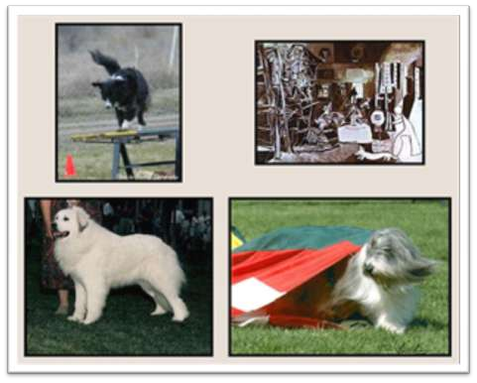
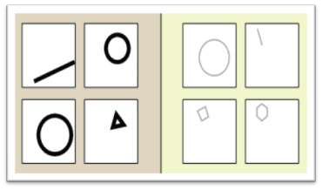
Some Screenshots of
Graphics
Based
CAPTCHA
a.
GIMPY CAPTCHA
b.
PIX CAPTCHA

Slide 37

Audio Based CAPTCHA
▪
These are based on humans ability to depict sounds that
may be distorted, following algorithm is followed in
using it:
a) Pick a word or a sequence of numbers at random
b) Render them into an audio clip using a TTS software
c) Distort the audio clip
d) Ask the user to identify and type the word or numbers

Slide 38
CAPTCHA
Where to use CAPTCHAs?
●
●
●
●
●
●
●
●
Data Collection
Worms and Spam
Preventing Comment Spam in Blogs
Protecting Email Addresses From
Online Polls
Protecting Website Registration Preventing Dictionary Attacks Search Engine Bots
Scrapers
26

Slide 39
CAPTCHA
Where to use CAPTCHAs?
●
●
Preventing Comment Spam in Blogs.
Protecting Email Addresses From
Scrapers. Mechanism to hide your email address,
require users to solve a CAPTCHA before showing
your email address
Online Polls. You cannot trust the results of an
online poll because anybody could just write a
program to vote for their favorite option thousands of
times.
●
27

Slide 40
CAPTCHA
Where to use CAPTCHAs?
●
Protecting Website Registration. (E-mail
services: Yahoo, Microsoft, Google)
Preventing Dictionary Attacks (in password
systems). Prevent a computer to iterate through the
entire space of passwords by requiring it to solve a
CAPTCHA after a certain number of unsuccessful
logins.
Search Engine Bots. It is sometimes desirable to
keep webpages unindexed to prevent others from
finding them easily.
●
●
28

Slide 41
CAPTCHA
Guidelines
●
Image Security. Images of text should be
distorted randomly before being presented the user.
to
●
Script Level Security. Insecurities:
•
•
Systems that pass the answer in plain text;
Systems where a solution to the same CAPTCHA
can be used multiple times ("replay attacks").
29

Slide 42
CAPTCHA
Guidelines
●
Security Even After Wide-Spread
Adoption. There are CAPTCHAs that would be insecure if a significant number of sites started using
them.
•
•
Example: text-based questions;
A parser could easily be written that would allow bots to bypass the test;
Such “CAPTCHAs” rely on the fact that few sites use them, and thus that a bot author has no incentive to program their bot to solve that challenge.
•
30

Slide 43

CAPTCHA
Guidelines
●
Accessibility.
•
CAPTCHAs prevent visually impaired users (for
example, due to a disability or because it is difficult to read) from accessing the protected resource;
They use screen reader, so when you reached an image, all it can do is to read the caption of that image;
•
•
Solution: permitting users to opt for an audio
or
sound
CAPTCHA.
31

Slide 44
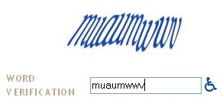
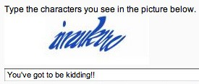
CAPTCHA
Guidelines: Accesibility
Hard
to
read
CAPTCHAs:
32

Slide 45
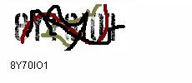

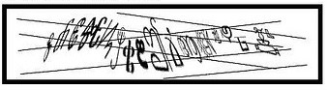
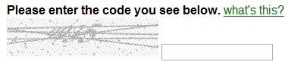
CAPTCHA
Guidelines: Accesibility
Worst
CAPTCHAs:
33

Slide 46
CAPTCHA
Ways to break CAPTCHAs
●
Exploiting bugs in the implementation that
allow the attacker to completely bypass the
CAPTCHA;
Improving Character Recognition software
●
(OCR – Optical Character
Using cheap human labor tests (sweatshops).
Recognition );
to process the
●
34

Slide 47
CAPTCHA
Break: Insecure implementation
●
Re-using the session ID of a known
CAPTCHA image.
Other CAPTCHA use a hash of the solution
as a key passed to the client to validate.
Often it is small enough size that it can be
cracked.
Other implementations use only a small fixed pool of CAPTCHA images (Asirra – 3 millions).
●
●
35

Slide 48
CAPTCHA
Break: Character Recognition
●
Programs that have the following functions:
•
•
Extraction of the image from the web page
Removal of background clutter, for example with color filters and detection of thin lines;
Segmentation, i.e. splitting the image into regions each containing a single letter;
Identifying the letter for each region.
•
•
36

Slide 49


Applications
Email services:
CAPTCHAs are used in attempts to prevent automated software from performing actions which degrade the quality of service of a given system,whether due to abuse or resource expenditure. CAPTCHAs can be deployed to protect systems vulnerable to e-mail spam, such as the webmail services
of Gmail, Hotmail, and Yahoo! Mail..
▪

Slide 50

Applications
Continues…
Dictionary attacks:
CAPTCHAs can also be used to prevent dictionary attacks in password systems. The idea is simple: prevent a computer from being able to iterate through the entire space of passwords by requiring it to solve a CAPTCHA after a certain number of unsuccessful logins.
▪

Slide 51

Applications
Continues…
Protecting Website Registration:
Several companies (Yahoo!, Microsoft, etc.) offer free email services. Up until a few years ago, most
▪
of
these services suffered from a specific type of attack:
"bots" that would sign up for thousands of email
accounts every minute. The solution to this problem
was to use CAPTCHAs to ensure that only humans
obtain free accounts. In general, free services should
be protected with a CAPTCHA in order to prevent
abuse by automated programs.

Slide 52
CAPTCHA
Attacks – EZ-Gimpy 2000
●
●
Yahoo's early CAPTCHA called "EZ-Gimpy“;
The program picks a word from a dictionary, and produces a distorted and noisy image of the word;
Algorithm for breaking EZ-Gimpy (92%):
1. Locate possible letters at various locations;
2. Construct graph of consistent letters;
3. Look for plausible words in the graph.
●
37

Slide 53

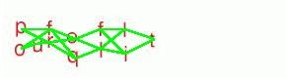

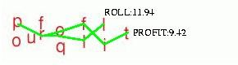
CAPTCHA
Attacks – EZ-Gimpy 2000
EZ-Gimpy
Graph
of
Letters
Poss b e Le ers
P aus b e Words
i
l
tt
l
i
l
38

Slide 54
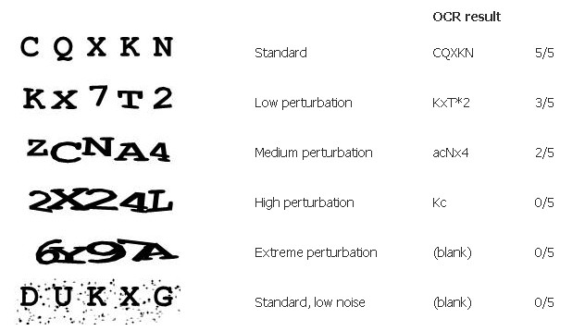
CAPTCHA
Attacks
–
SimpleOCR
Engine
2002
39

Slide 55


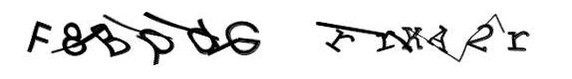
CAPTCHA
Attacks
–
Jan/Feb
2008
Google
(Jan 17) 20%
Hotmail
(Feb 6) 30-35%
Yahoo
(Feb 22) 30-35%
40

Slide 56
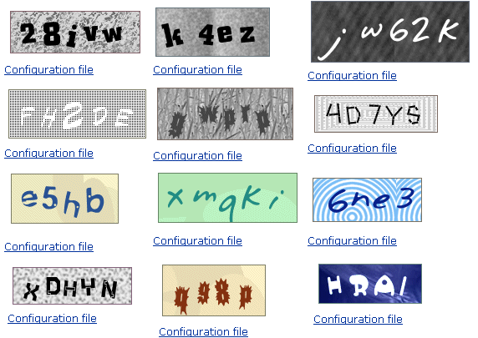
CAPTCHA
Attacks – Projects
Several broking CAPTCHAs projects:
•
•
http://libcaca.zoy.org/wiki/PWNtcha
http://www.lafdc.com/captcha/
41

Slide 57






Processes
Generate CAPTCHA
Align CAPTCHA
Cut CAPTCHA
Transform CAPTCHA
Decode CAPTCHA

Slide 58
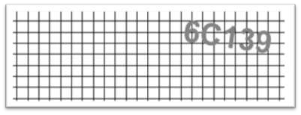
Generate
captcha
Continues...
CAPTCHA generated with our Mathematical
code.

Slide 59

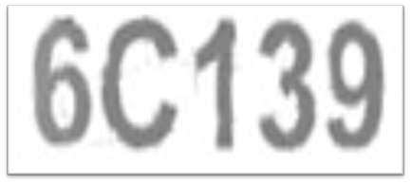

Align
captcha
Continues...
Remove gridlines
➢Crop CAPTCHA
Undo angle of rotation

Slide 60
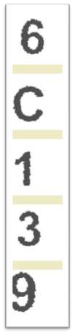
Cut
captcha
Continues...
Cut CAPTCHA cut into 5 pieces.

Slide 61
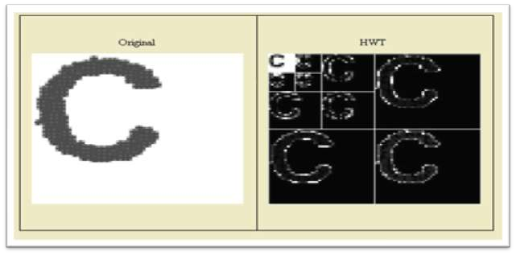
Transform captcha
Continues...
Perform the HWT on each of the 5 pieces

Slide 62
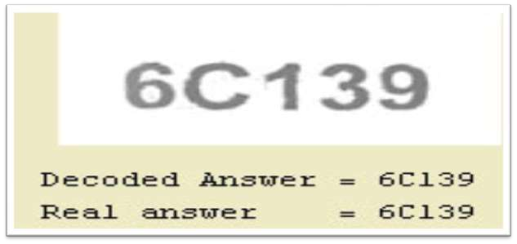
Decode
captcha
Continues...
Decoding the captcha

Slide 63

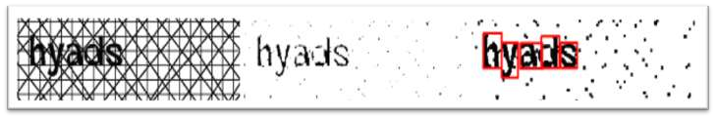
Breaking CAPTCHA
Most text based CAPTCHAs have been broken
software
▪ OCR(Optical Character Recognization)
▪ Segmentation
by
Other CAPTCHAs were broken by streaming
for unsuspecting users to solve.
the tests

Slide 64



Re-Captcha
Free captcha service that helps
to digitize
books, newspaper and old time radio shows.
Recaptcha improves the process of digitizing
books by sending words that can’t be read by
computers to the web in form of captchas for
human to decipher.

Slide 65
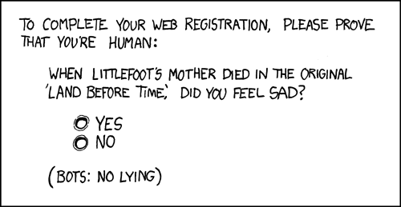
CAPTCHA
Next CAPTCHA Generation
●
CAPTCHAs can be made stronger, but they are already
too advanced for a large percentage of Internet users;
●
CAPTCHA devolves from a simple human
reading
test
into
an
intelligence
test
or
an
acuity
test.
47

Slide 66
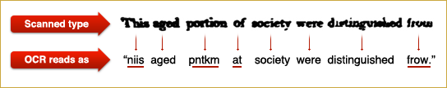
CAPTCHA
reCAPTCHA (2007)
●
New form of CAPTCHA
digitize books;
The words displayed to
that also helps
●
the user come directly
from old books that are being digitized;
●
Words
that
OCR
could
not
identify;
48

Slide 67
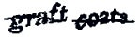
CAPTCHA
reCAPTCHA
●
●
Pairs an unknown word with a known one;
Distorts them both and puts a line through them and then sent them to be proofread;
Respondent answers both elements:
●
•
•
half of effort validates the challenge;
the other half is captured as work.
49

Slide 68
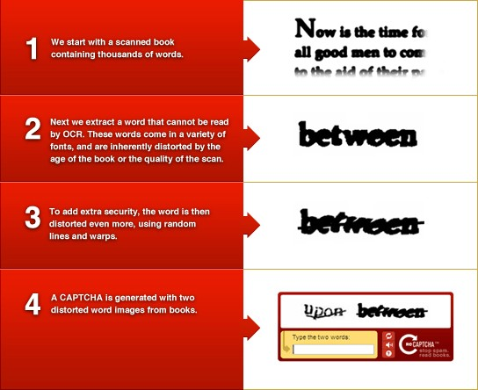
CAPTCHA
reCAPTCHA
50

Slide 69
Working of Re-Captcha
Continues...
Two words are shown, one word is known
control word and another one is known as
questionable word.
as
a
System assumes that if human types the
control word correctly, then the questionable
word is also correct.

Slide 70
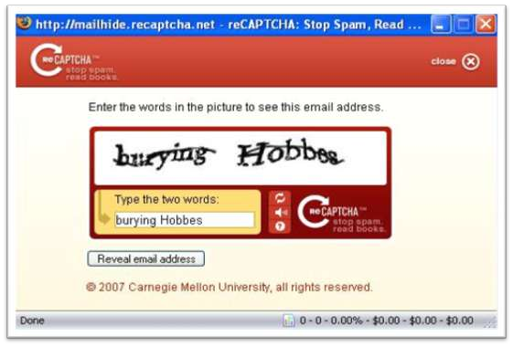
Example of Re-Captcha
Continues...

Slide 71

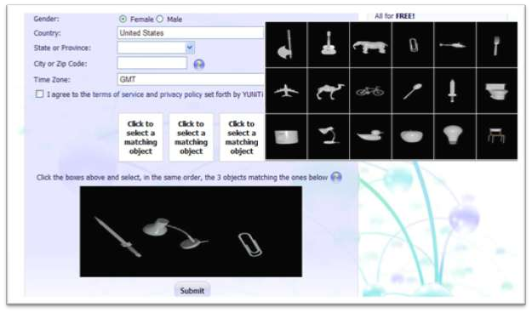
New unbreakable Captcha
Used at: http://www.yuniti.com/register.php

Slide 72

Benefits
The database already exists and is public.
The database is constantly being updated
maintained.
and
Adding “concrete objects” to the dictionary is
virtually instantaneous.
Distortion prevents caching hacks.
Quick expiration limits streaming hacks.

Slide 73

Drawbacks
Not accessible to people with disabilities
is the case of most CAPTCHAs).
(which
Relies on Google’s infrastructure.
Unlike CAPTCHAs using random letters
and
numbers, the number of challenge words is
limited.

Slide 74

Conclusion
Captchas are an effective way to
spam
and reduce
They serves dual purpose- help advance AI
knowledge
Applications are varied from stopping bots to
character reorganization and pattern matching.

Slide 75
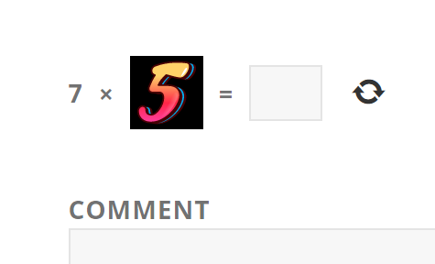


reCAPTCHA VS CAPTCHA
Captcha asks you to complete the math equation like addition, subtraction, or multiplication. The equation can show up using numbers, letters, or images, therefore bots have no chances.
ReCaptcha is a system similar to captcha which also serves to protect the website and, at the same time, assists in the digitization of books (even its slogan was “Stop Spam, Read Books”). It supports two versions. The first offers you to enter some words or digits from the image, and the second offers you to mark the checkbox “I’m not a robot”.

Slide 76

More Clear
The acronym of CAPTCHA is "Completely Automated Public Turing test to tell Computers and Humans Apart". It tests whether the user is a human or computer to prevent spam and automated data downloading. It typically asks the user to write down a combination of alphabets/numbers from an image. The text cannot be copy pasted from the image, thus preventing computers any access. Below pic is an example of CAPTCHA:

Slide 77

More Clear
reCAPTCHA: This idea an interesting application of CAPTCHA. There are several projects of converting books to the ebook version. One method is to scan the books and use OCR software to convert image of text to actual text. But somebody has to validate whether the conversion is successful. Luis von Ahn, Ben Maurer, Colin McMillen, David Abraham and Manuel Blum at Carnegie Mellon University developed reCAPTCHA to help in this problem. Instead of random texts in CAPTCHA, actual texts from scanned books are shown. The user writes the digital text. This is used to validate each word from several users. Below pic is an example of reCAPTCHA:

Slide 78

Captcha and reCAPTCHA do the same thing, but in different ways. Is that all? No. They also have differences in their features. Let’s compare them:

Slide 79

https://www.similartech.com/compare/general-captcha-vs-recaptcha

Slide 80

References
Wikipedia(http://en.wikipedia.org/CAPTCHA)
Carnegie Mellon School of Computer Science Web site (http://www.captcha.net)
“Telling Humans and Computers Apart” by Luis von
Ahn and colleagues.
Xerox Palo Alto Research Center
(http://www2.parc.com/ istl/projects/captcha/)

